Slide 1
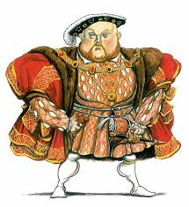
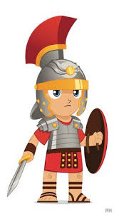
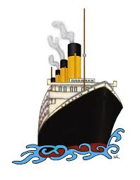
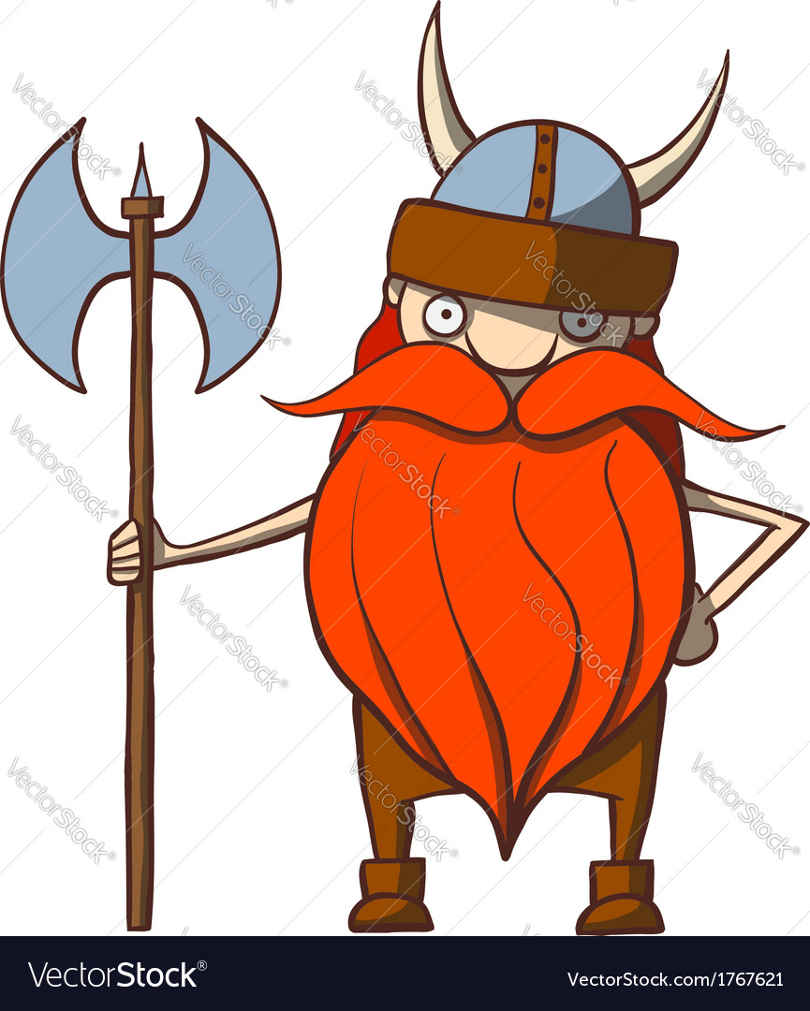
What is history?
Objectives:
To be able to explain why history is relevant today.
To learn about the importance of chronology.
Do now:
What does the word ‘history’ mean to you?

Slide 2
These are your next five lessons:

Slide 3
Active listening:
Click on the link below.
Watch clip carefully.
Write down at least three reasons why history is important.
https://www.youtube.com/watch?v=MH-poqMomhk
Notes:
3 mins approx

Slide 4
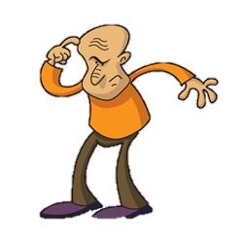
Show you know
Create a spider diagram to show your knowledge of history so far.
Think about…
History you studied at primary school
History you have seen on TV and /or in film
Historical buildings you have you visited
No fact too small – Record EVERYTHING!
Places
Objects
Where?
When?
Events
What?
Why?
Dates
People
Who?
Ready for more?
Which is your favourite historical period/ topic? Explain.

Slide 5
Read:

Slide 6
Here is an example of a timeline:

Slide 8
Show you know
Write a definition for each of the following key terms:
Chronology –
Timeline –
AD -
BC -
Ready for more?
Read the FACT! Box on page 6 and write three examples of periods of history.

Slide 9
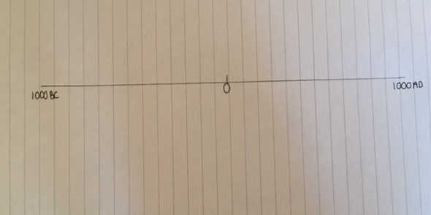
Show you know:
IN PENCIL, draw a 20 cm line in your book.
Mark on year ‘0’, 1000BC and 1000AD
2. IN PENCIL, Mark each off each 1cm.

Slide 10
Show you know:
3.On the right hand side of your timeline mark on the years 100 – 900AD

Slide 11
Show you know:
4.On the left hand side of your timeline mark on the years 100 – 900BC.
But this time you right them going BACKWARDS

Slide 12
Show you know:
5. Add the following dates to your timeline:
250 150BC 750BC
950 450 50BC
350BC 50 950BC 750
Ready for more?
Why are timelines useful to historians?

Slide 13
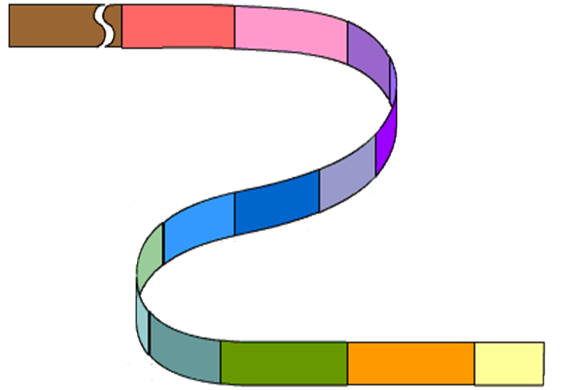
Chronology
Lesson 1
1976
1980
1985
I had my first holiday abroad – Tenerife!
I was born in Stockport
I did a handstand and broke my wrist
1988
I moved to Denton and started primary school
The timeline of my life by Mrs Anderton
Starts the year I was born
I trained to be a teacher at West Hill School.
1993
I sat my GCSE exams and passed all 10
1995
1999
My first nephew was born
Ends Today
I got married in and my son was born
I started working at West Hill School
My son started school
My brother moved to Australia
2009
2013
2014
2017

Slide 14
Show you know:
Create a timeline to show important events in your life.
Make sure the events are in chronological order!
Include 10 interesting facts about your life
Include factual detail
Include images

Slide 15
To finish…….
Write at least three new facts or new skills you have learned in this lesson.

