Slide 1
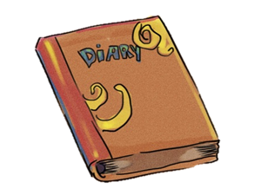
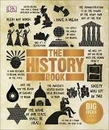
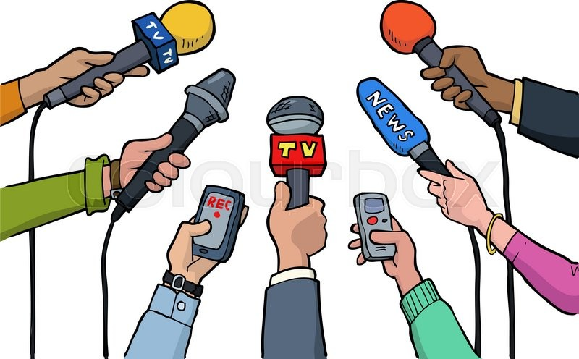
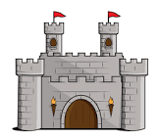
How do we know about our past?
Objectives:
To learn about the importance of sources.
To learn to evaluate sources
Do now:
What do you understand by the term ‘source’?

Slide 2
These are your next three lessons:

Slide 3
Active listening:
Click on the link below.
Watch clip carefully.
Answer this question:
Is it appropriate to dig up our past?
Explain your reasons
https://www.youtube.com/watch?v=m-cb1L7VZLM
Notes:
90 sec approx

Slide 4
Copy this information into your books
Key terms:
Primary source
Information that originates from that time in history. For example a diary.
Secondary source
Information created after that time in history.
For example a storybook based on a historical event.
Ready for more?
Add three more examples to each type of source.

Slide 5
Read:
Are ALL sources useful?
The simple answer is ‘yes!’
All sources are pieces of evidence that share information about our past.
Even if the information is exaggerated, a lie or even inaccurate. It can still teach us about WHY someone would exaggerate, lie or even be inaccurate.
Sources can give us factual information about a person or an event but they can also teach us about people’s individual experiences, views, worries and fears.
History can be confusing because people in our past have different experiences.

Slide 6
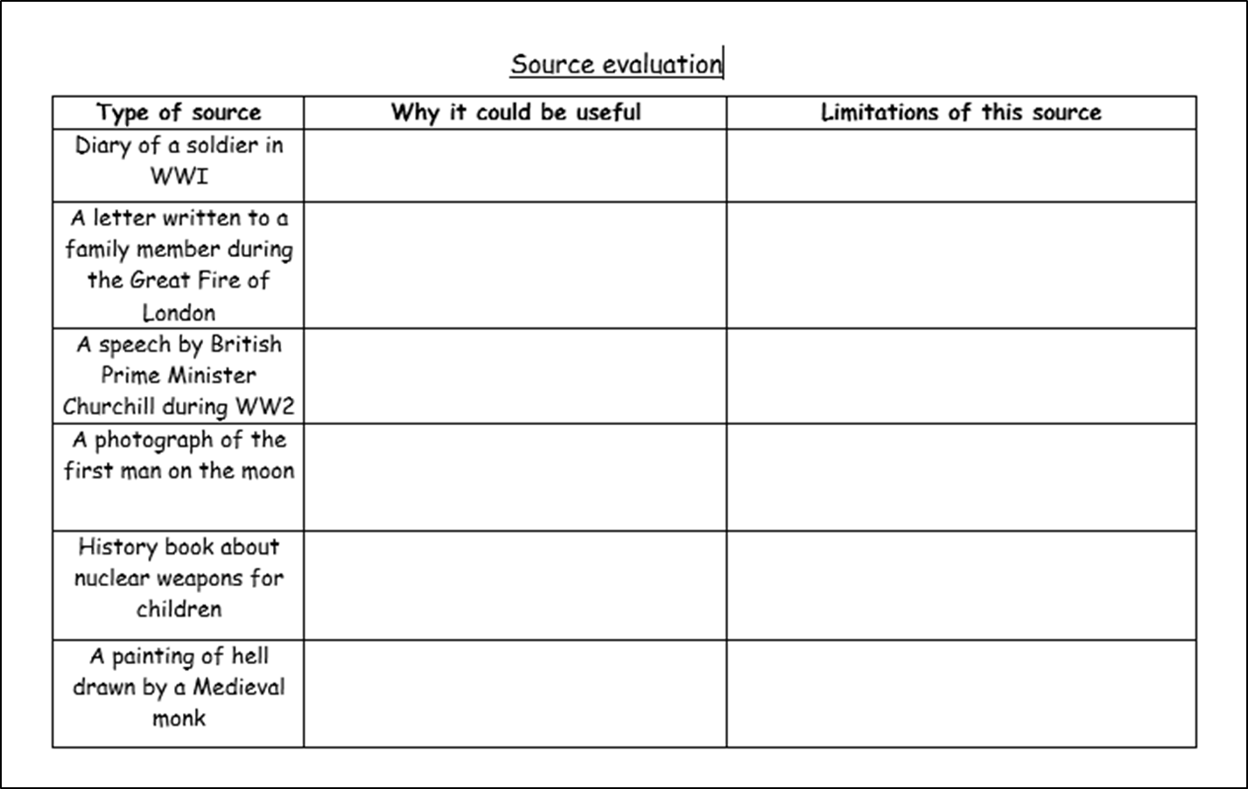
We are going to look at some different types of sources. As we study them, think about:
Why it could be useful
What the limitations (problems) could be
Complete the ‘source evaluation sheet’ found on the VLE.

Slide 7
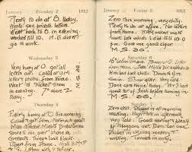
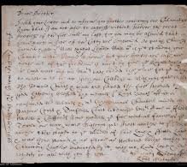
“fairly busy day, snipers nearly got me”
- Diary of a soldier in WWI
“my business is destroyed but I am safe”
- A barrister’s letter from the Great Fire of London

Slide 8
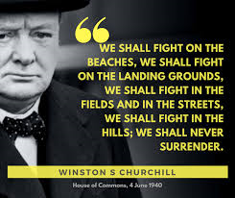
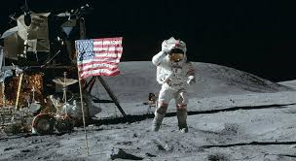
- Famous speech by Prime Minster Churchill in 1940, during the Second World War
- American photograph of Neil Armstrong, the first man on the moon in July 1969.

Slide 9
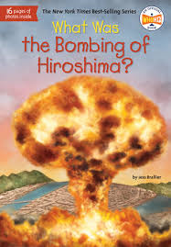
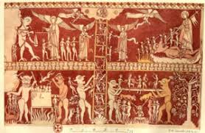
- An information book for children about the atomic bomb
A ‘doom’ painting by a medieval monk.
Medieval monks dedicated their lives to God and taught others to do the same.

Slide 10
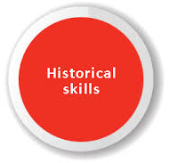
Let’s have a go!

Slide 11
Analysing sources
Read:
This means to study sources carefully to try and make sense of them.
Step 1: understand the source
Step 2: make inferences about the source
Step 3: evaluate the source.

Slide 12
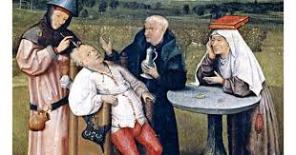
Study the image below:
A painting to show surgical methods.
This was produced during the Medieval era

Slide 13
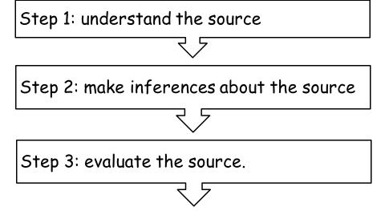
Show you know
1. Understanding the source
Find:
The patient
The doctor
The priest
The nun

Slide 14
Show you know
2. Make inferences (educated guesses)
What medical procedure is happening?
Does the patient think he will survive?
Was medieval surgery safe?
Where in the source is your evidence to support this?
Where in the source is your evidence to support this?
Where in the source is your evidence to support this?
Inference – what you can guess or suggest

Slide 15
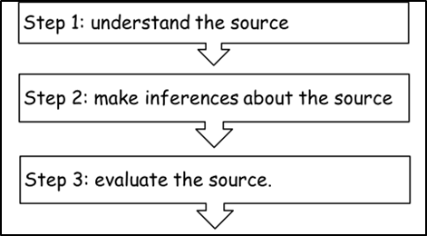
Show you know
3. Evaluate the source
How useful is this source for learning about medieval surgery?
This source is useful for learning about medieval surgery because….
However, the limitations/ problems are ….

Slide 16
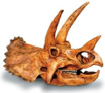
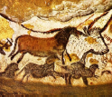
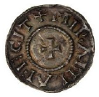
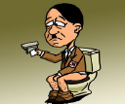
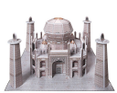
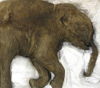
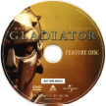
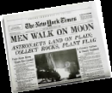
To finish…
For each of sources below decide if they are Primary or Secondary
Dinosaur bone
History Textbook
Cave Art
Viking coin
Taj Mahal Model
Computer Game
Frozen Mammoth
Hitler Cartoon
Newspaper
Photographs
Training Shoe
DVD Movie

